Slide 1

LocalBuddy
Academic year 2018 - 2019
Prof. Luciano Baresi
Design and Implementation of Mobile Applications
Papale Michele - 899694

Slide 2
Concept
make comfortable as much as possible a travel in a new place where you have never been
connect a traveler with a local person - buddy
The traveler will choose a city and the application will list all the local buddies available
Main functionalities:
chat
meetings
feedbacks
Main idea is to allow people to find a “friend”

Slide 3
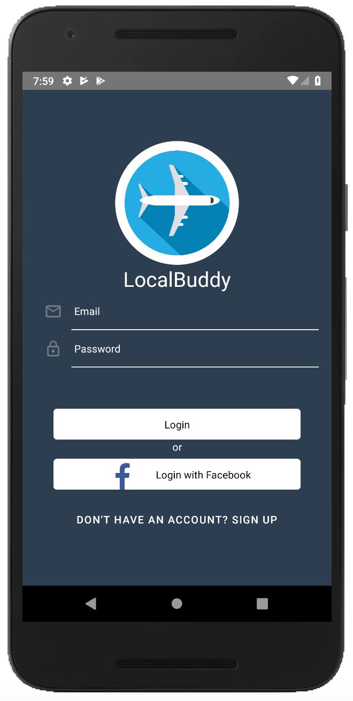
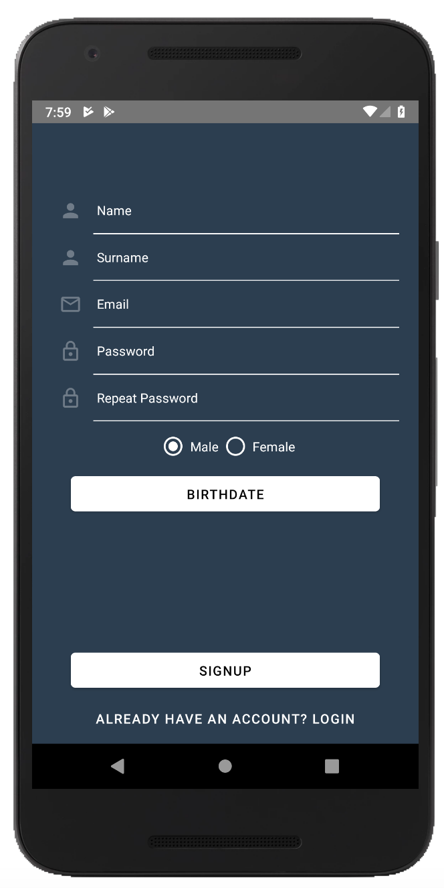
Functionalities - Login and SignUp

Slide 4
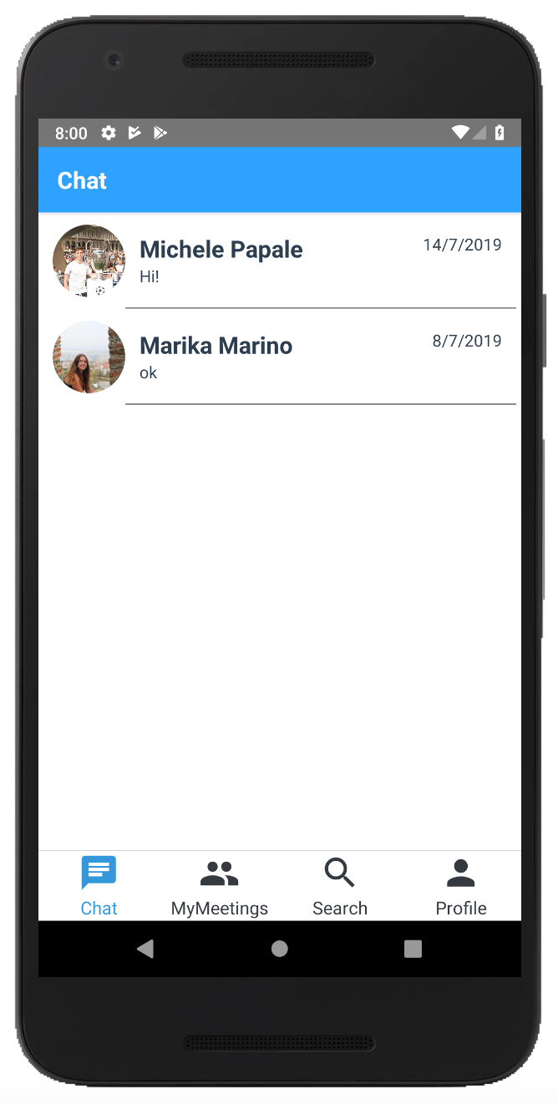
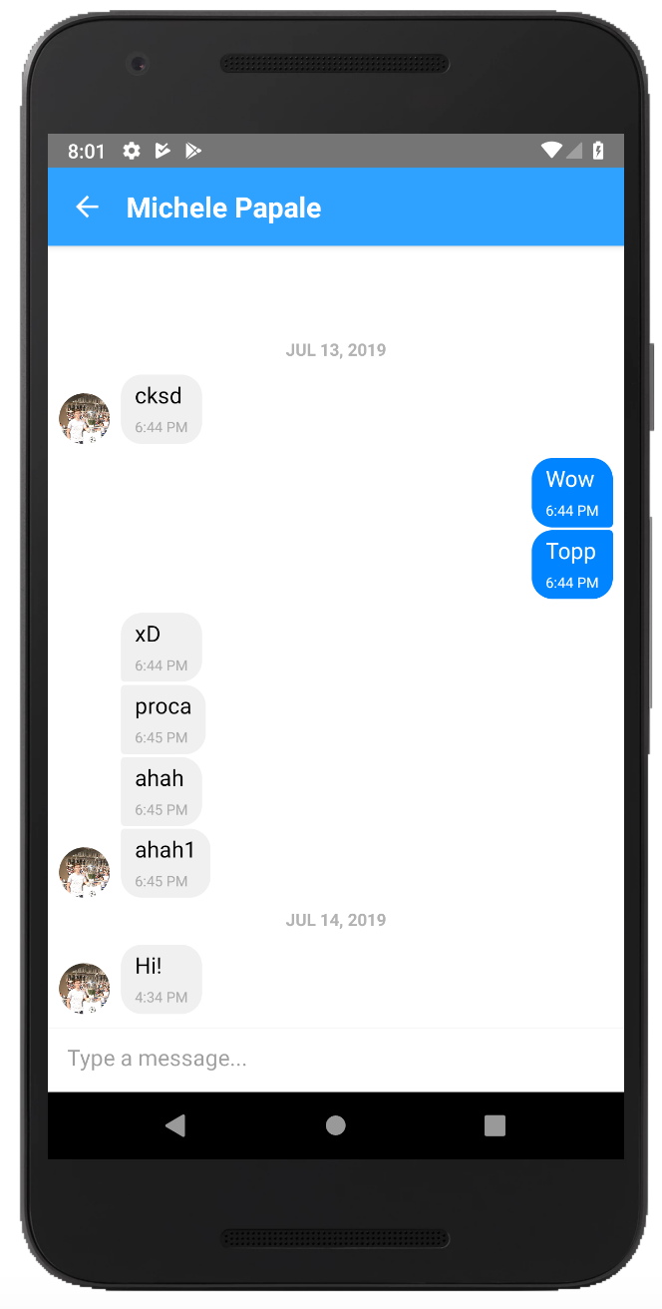
Functionalities - Chat

Slide 5
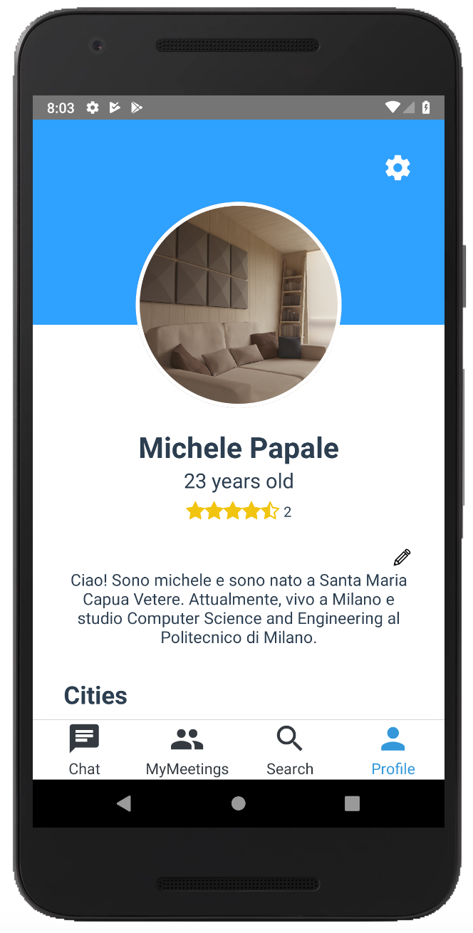
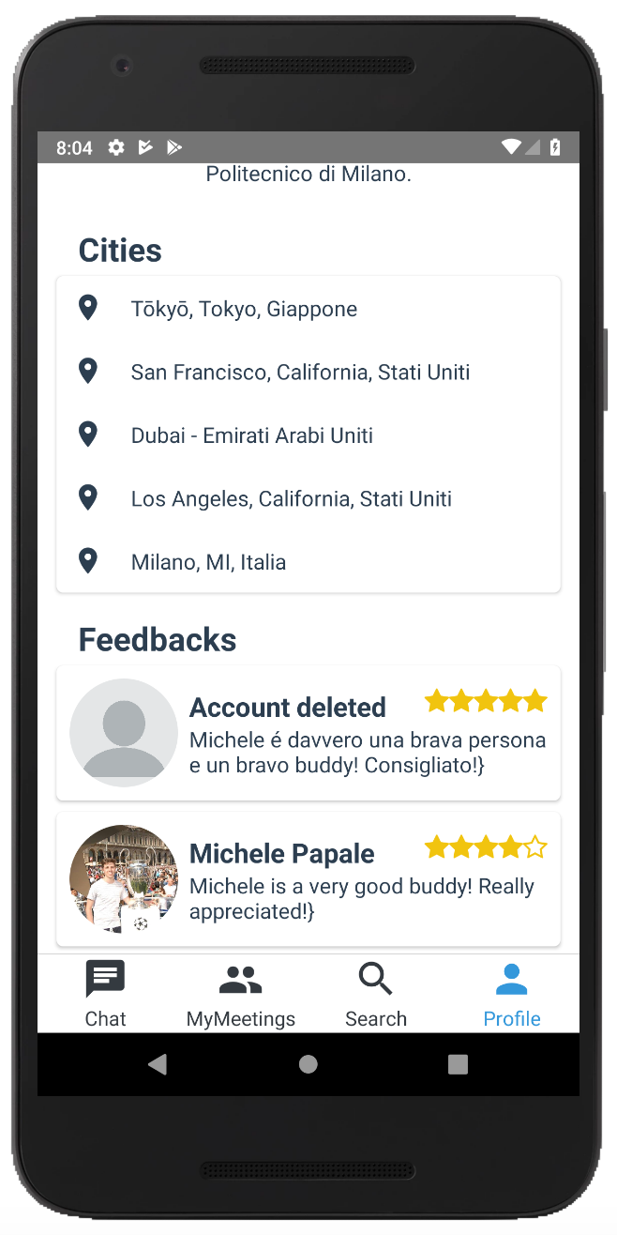
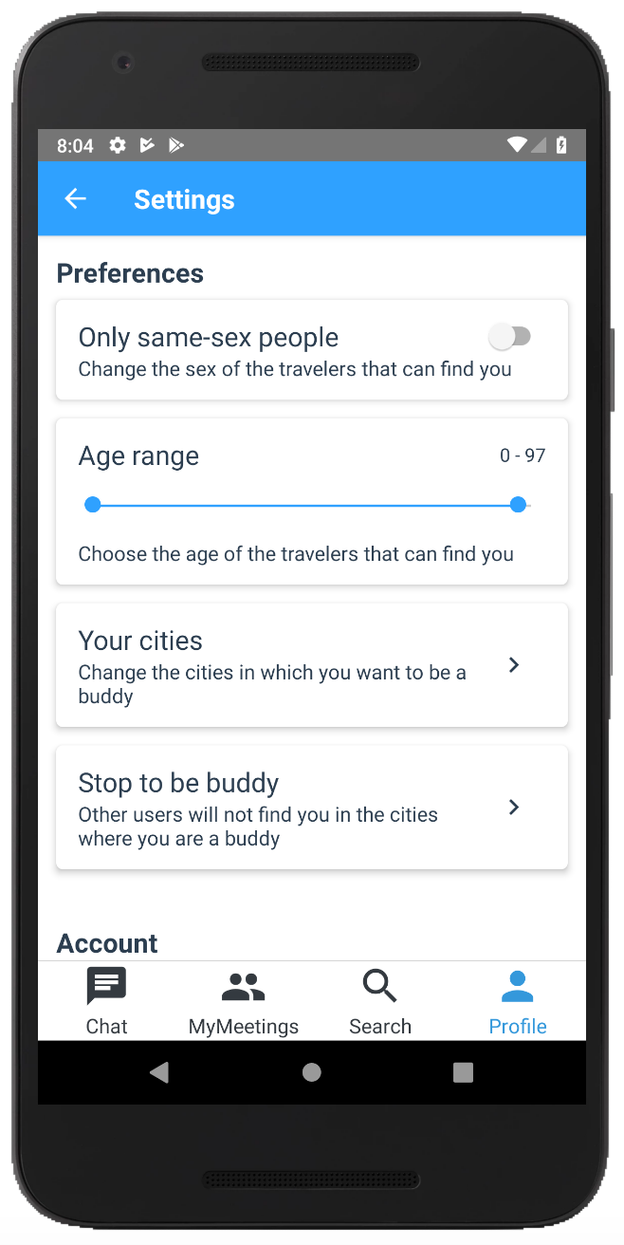
Functionalities - User Profile and Settings

Slide 6
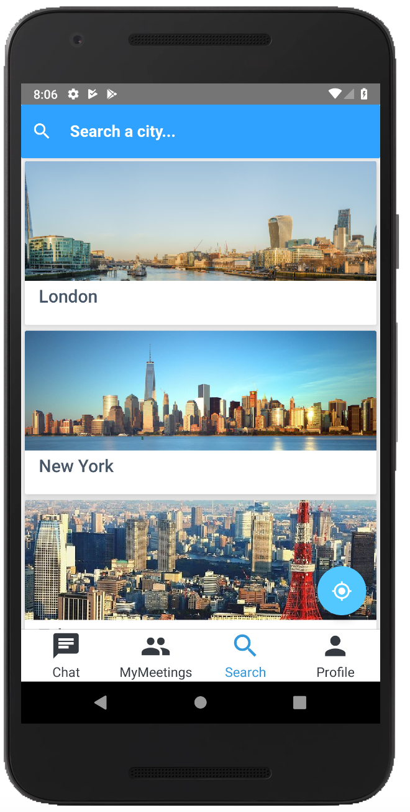
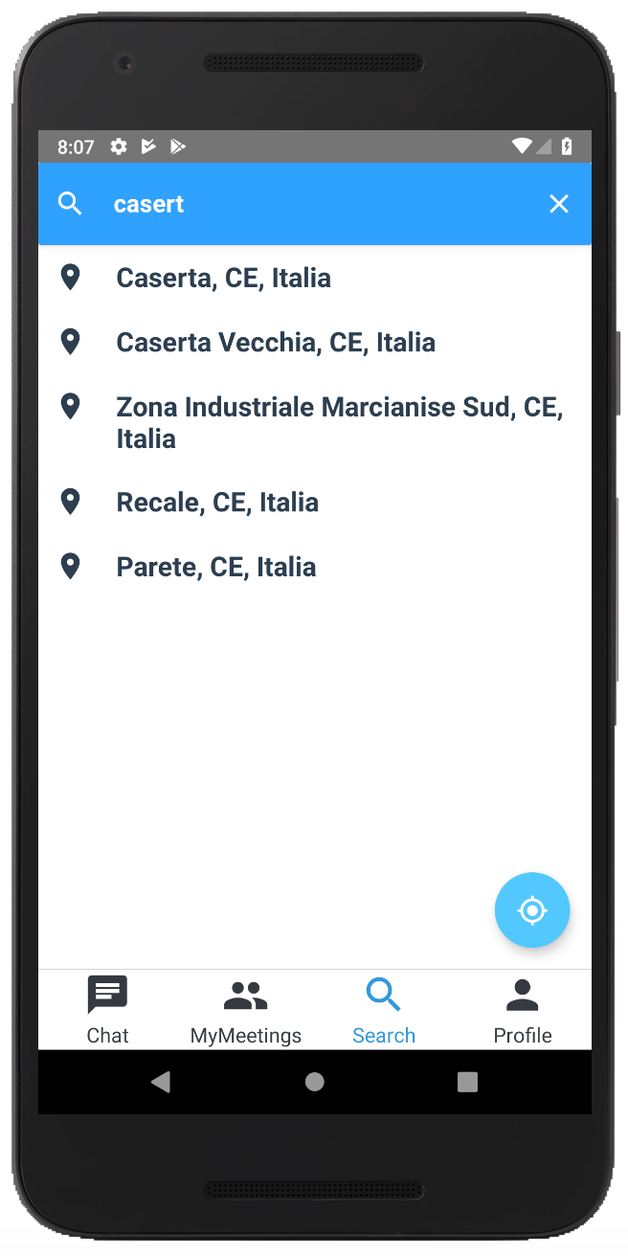
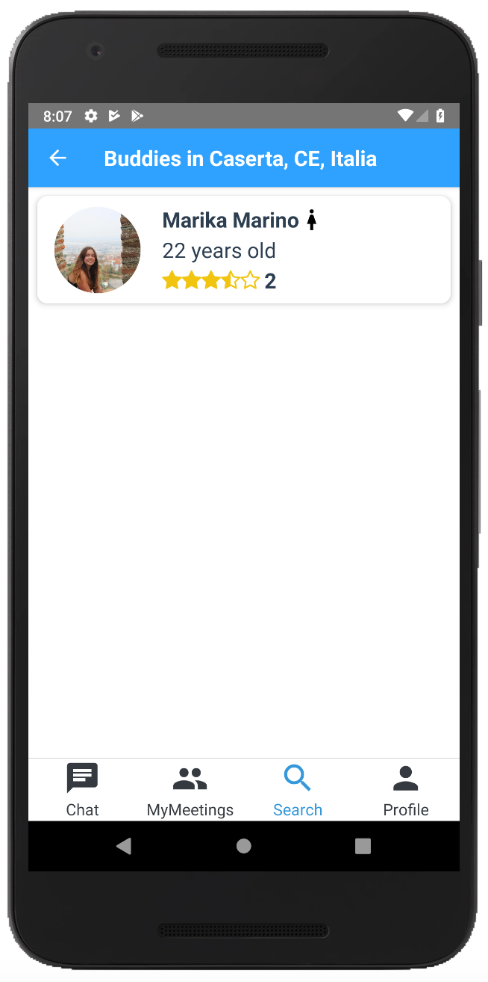
Functionalities - looking for a buddy

Slide 7
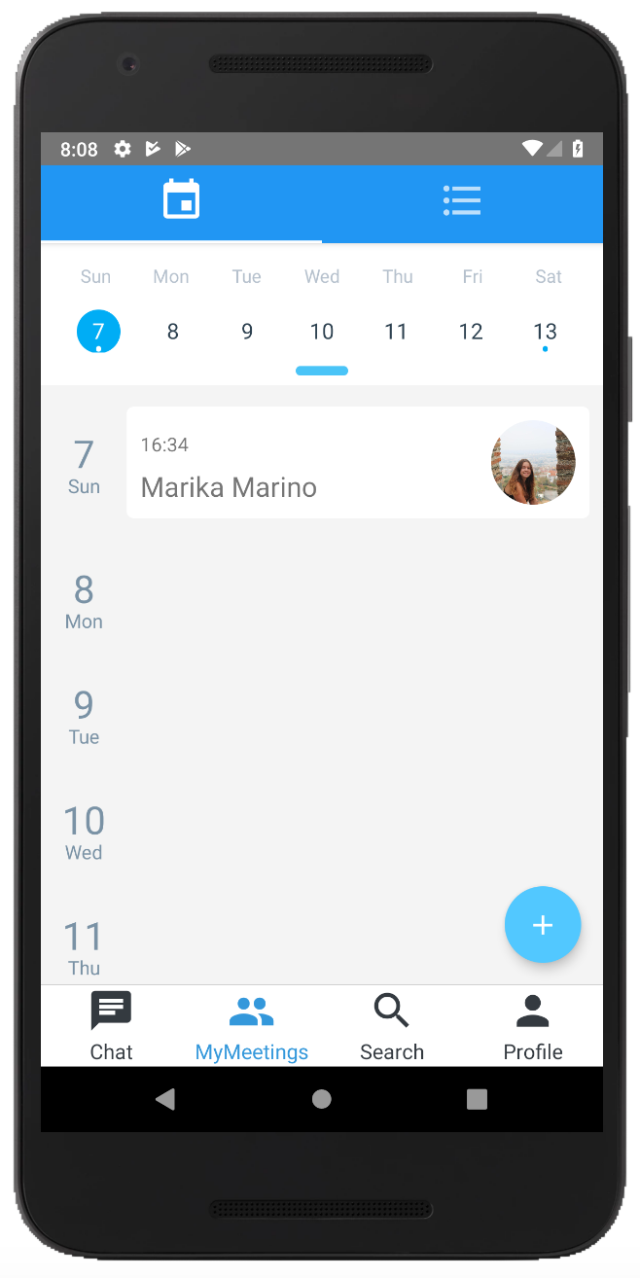
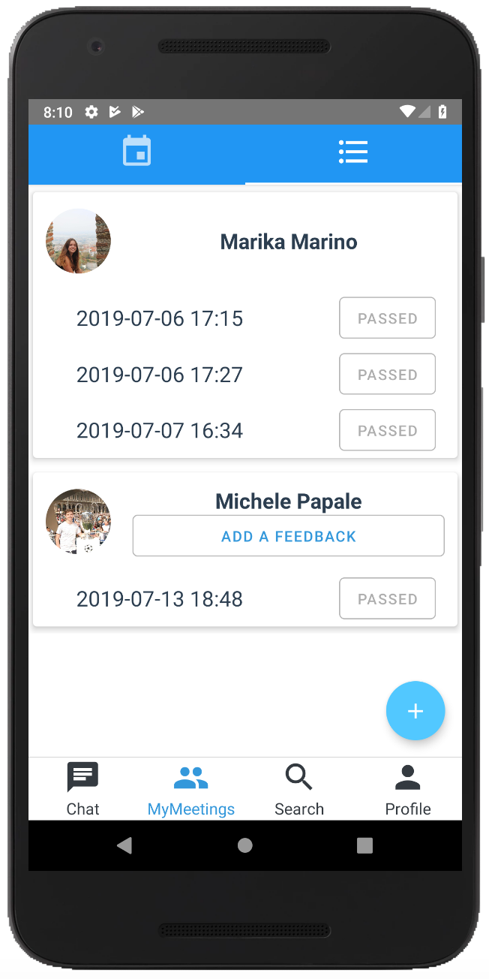
Functionalities - Meetings

Slide 8
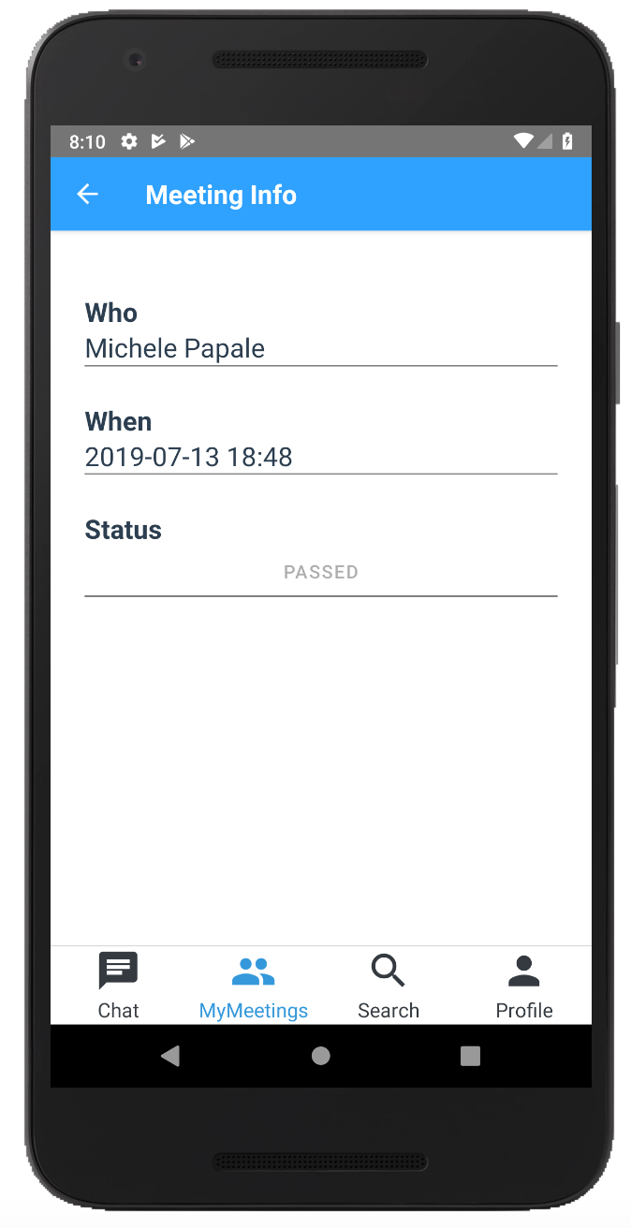
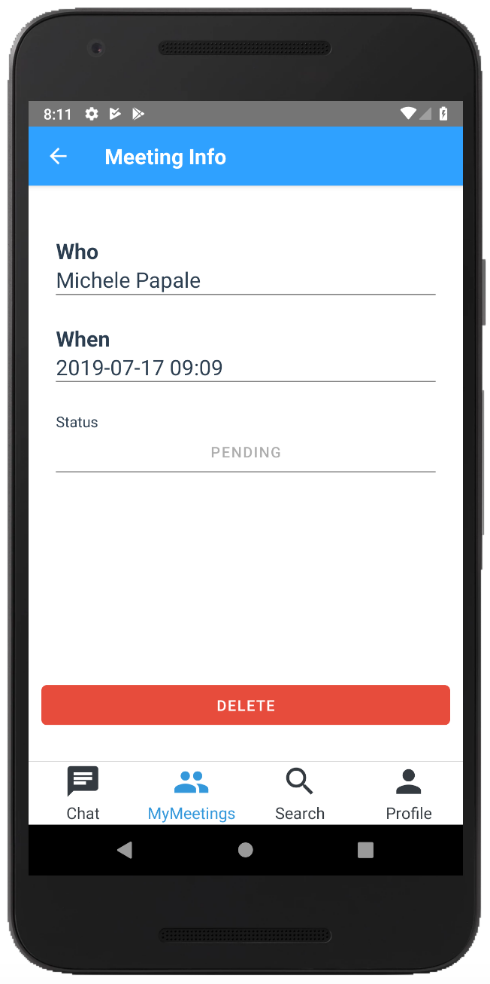
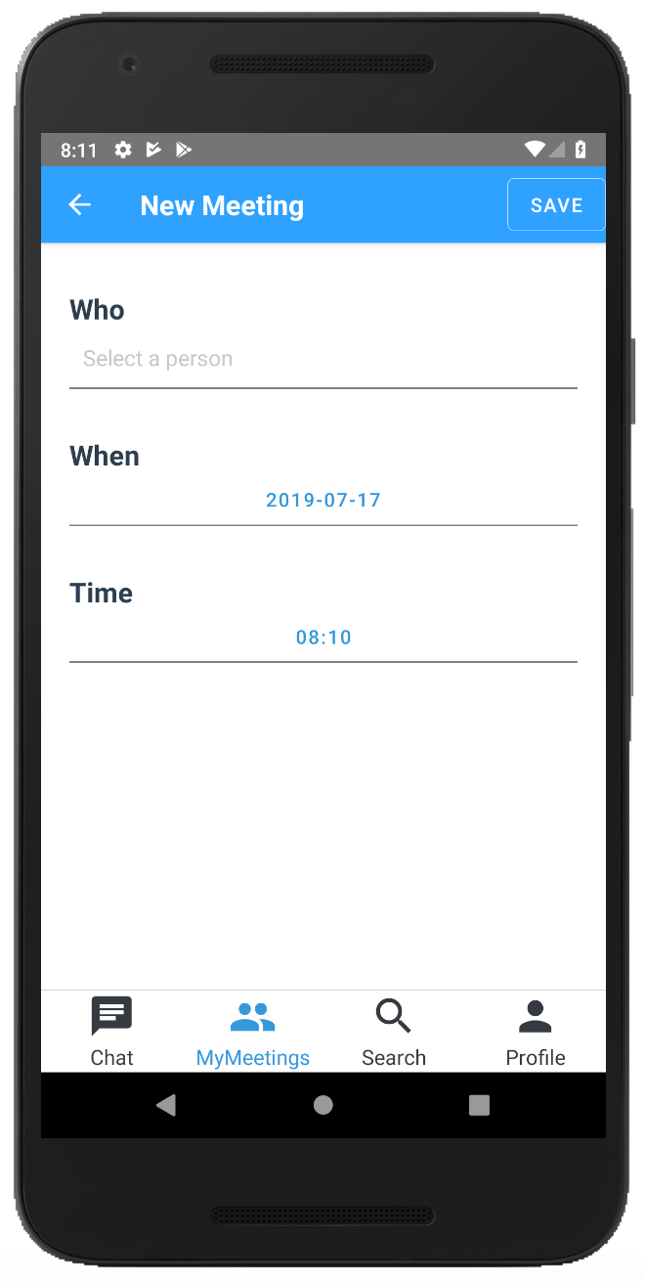
Functionalities - Meetings

Slide 9
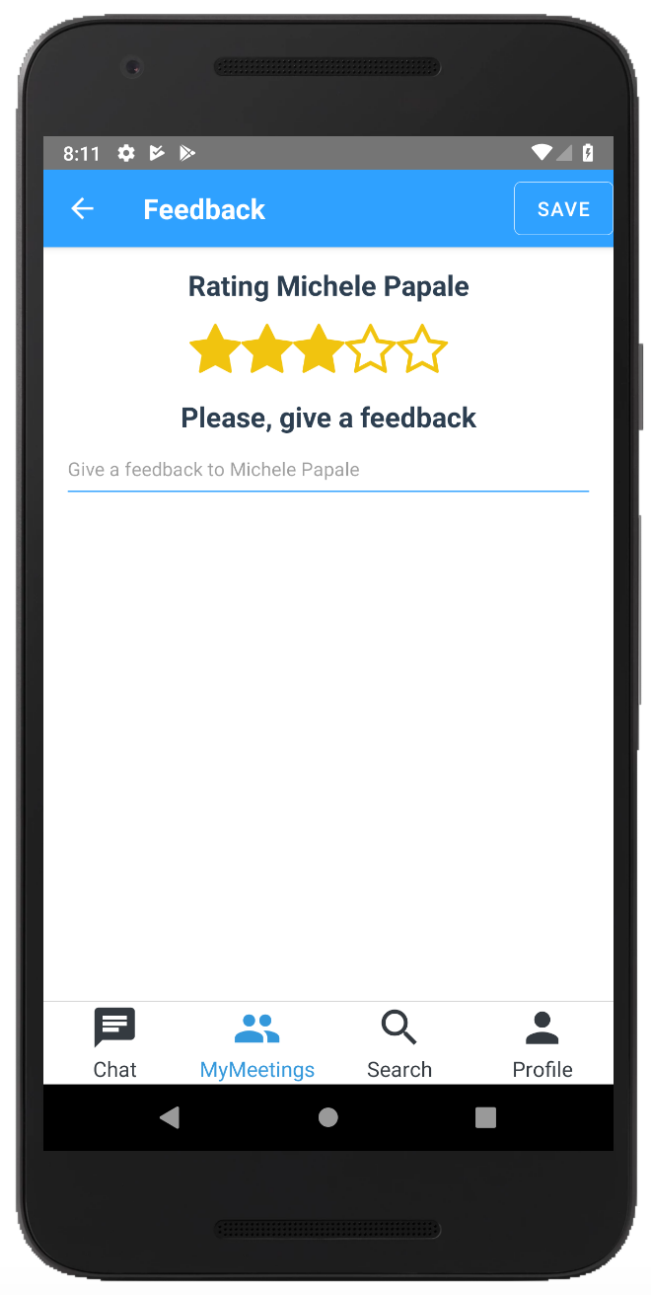
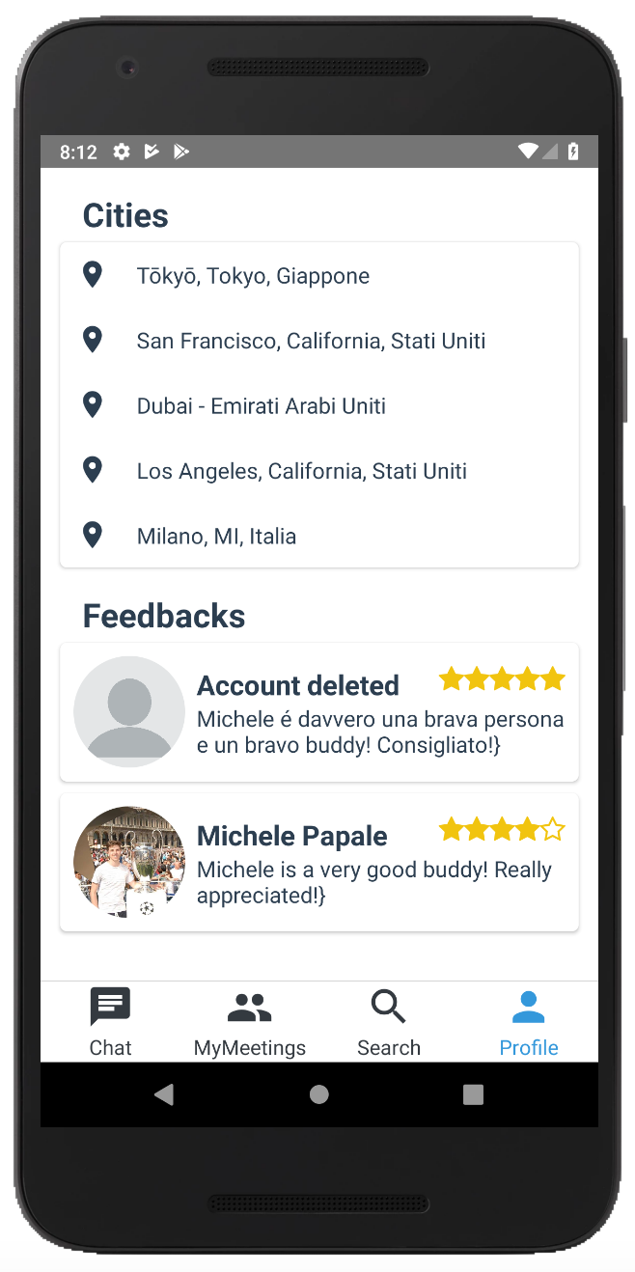
Functionalities - Feedbacks

Slide 10
LocalBuddy
Architecture

Slide 11
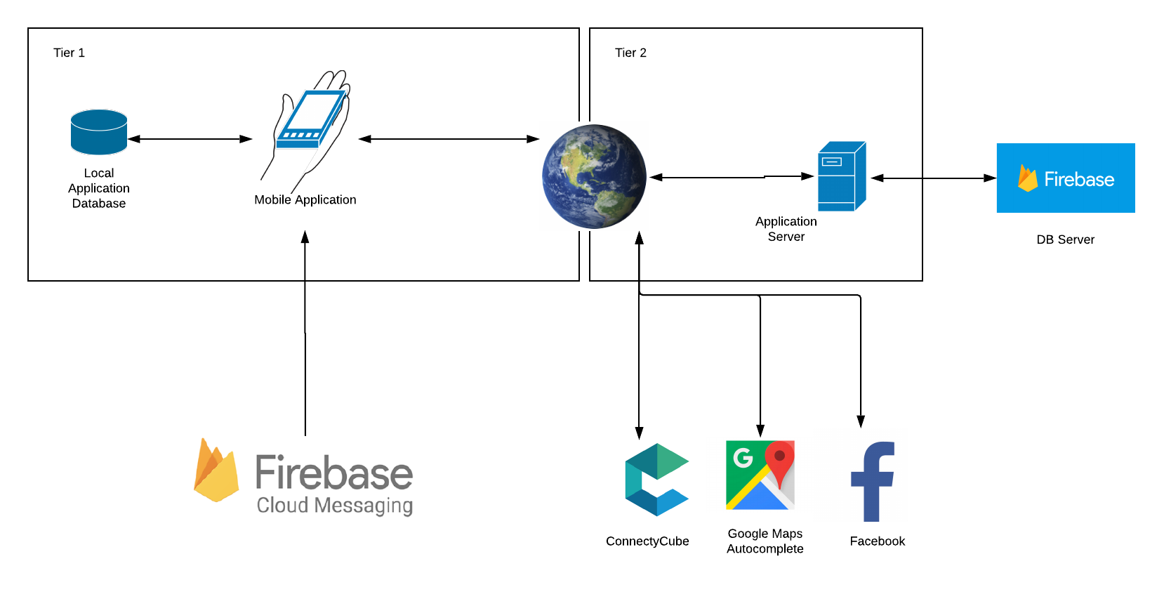
Architectural Design
2 Tier Architecture
Fat Client
Application Server
External services

Slide 12
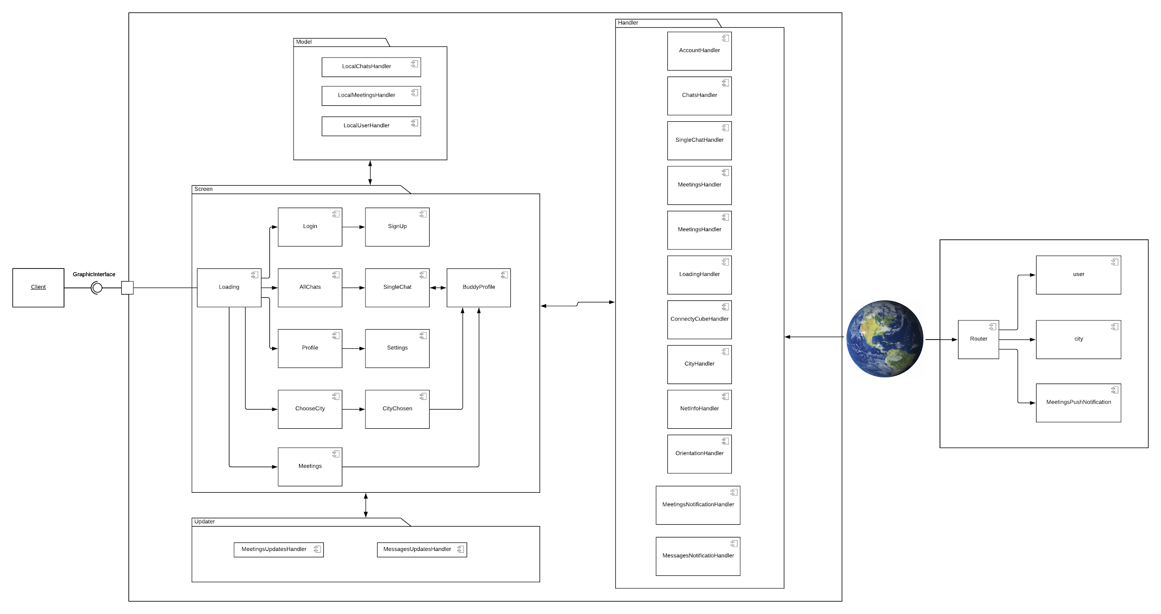
Component View

Slide 13
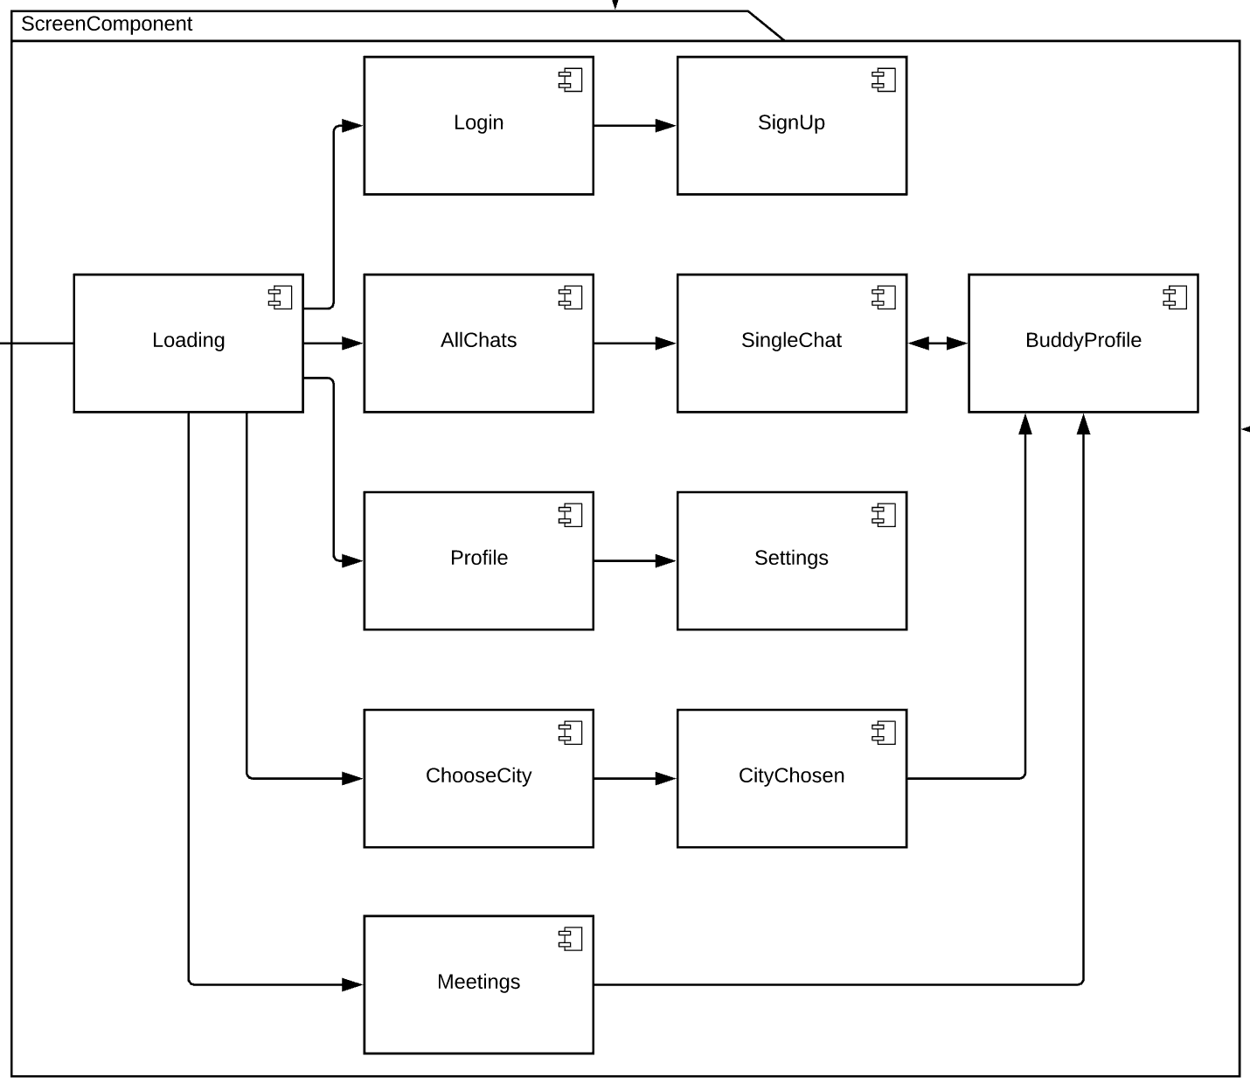
Component View - screen components

Slide 14
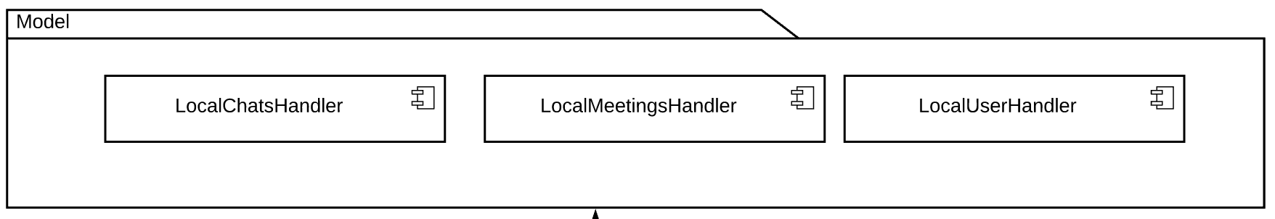
Component View - model handler components

Slide 15
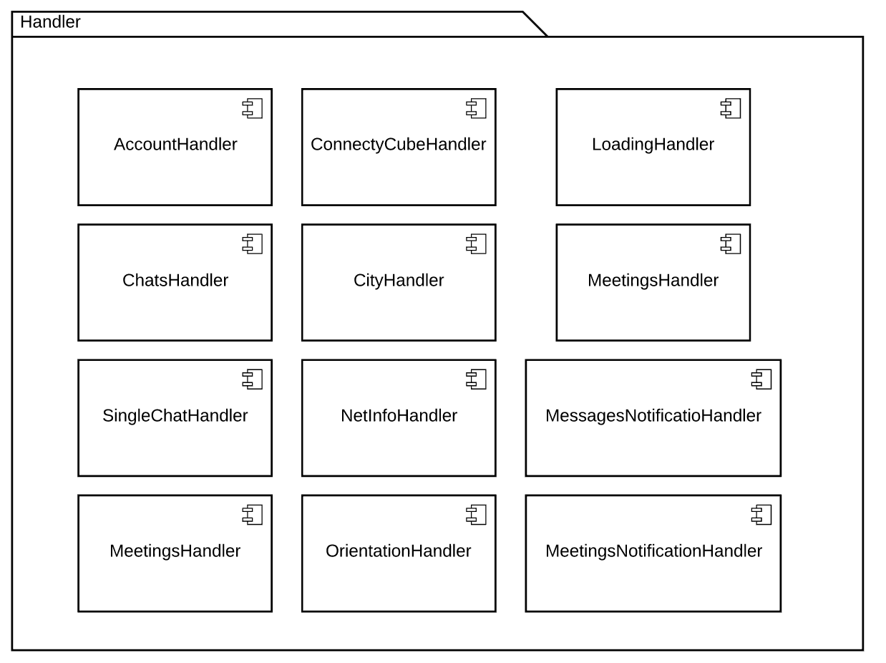
Component View - backend handler components

Slide 16
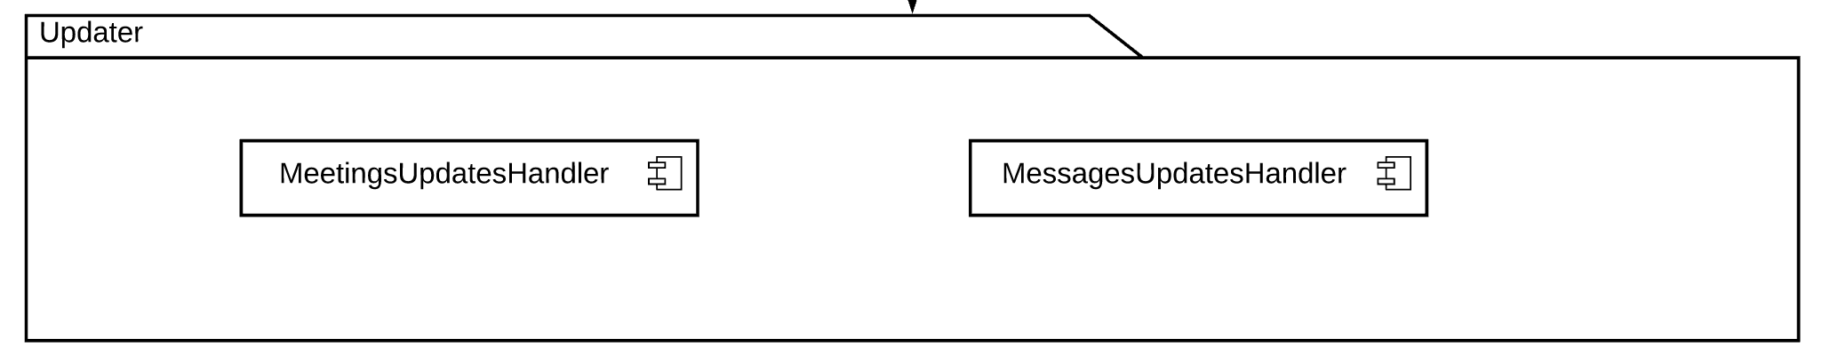
Component View - updater components

Slide 17
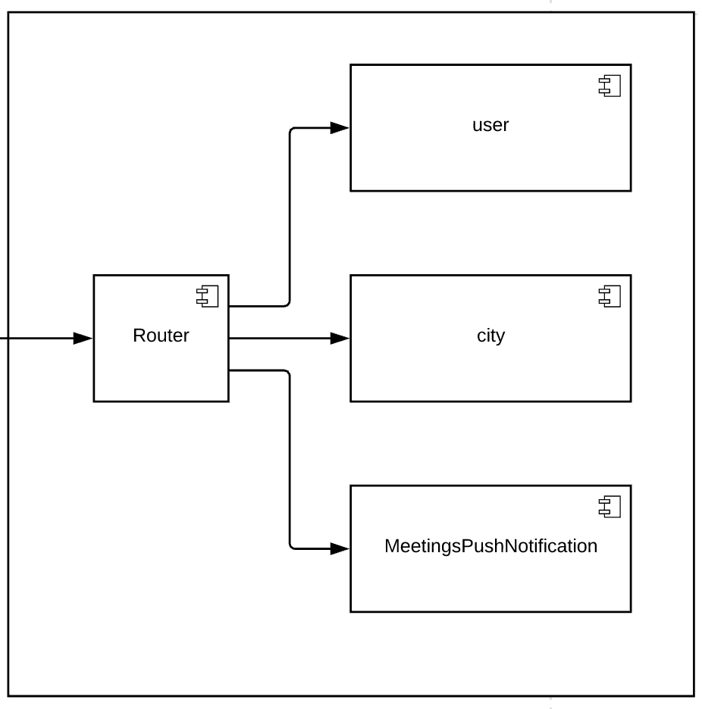
Component View - server components

Slide 18
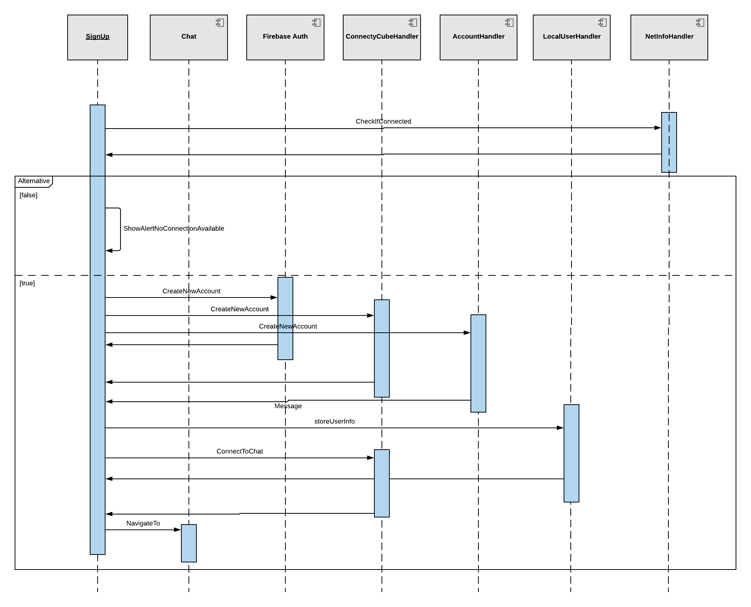
Runtime View - Sign Up

Slide 19
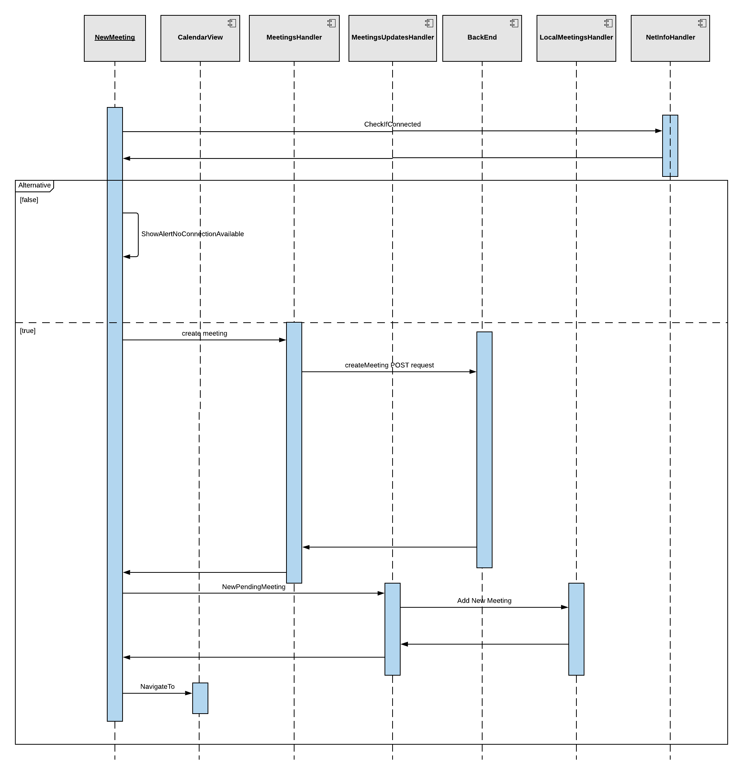
Runtime View - Creating a meeting

Slide 20
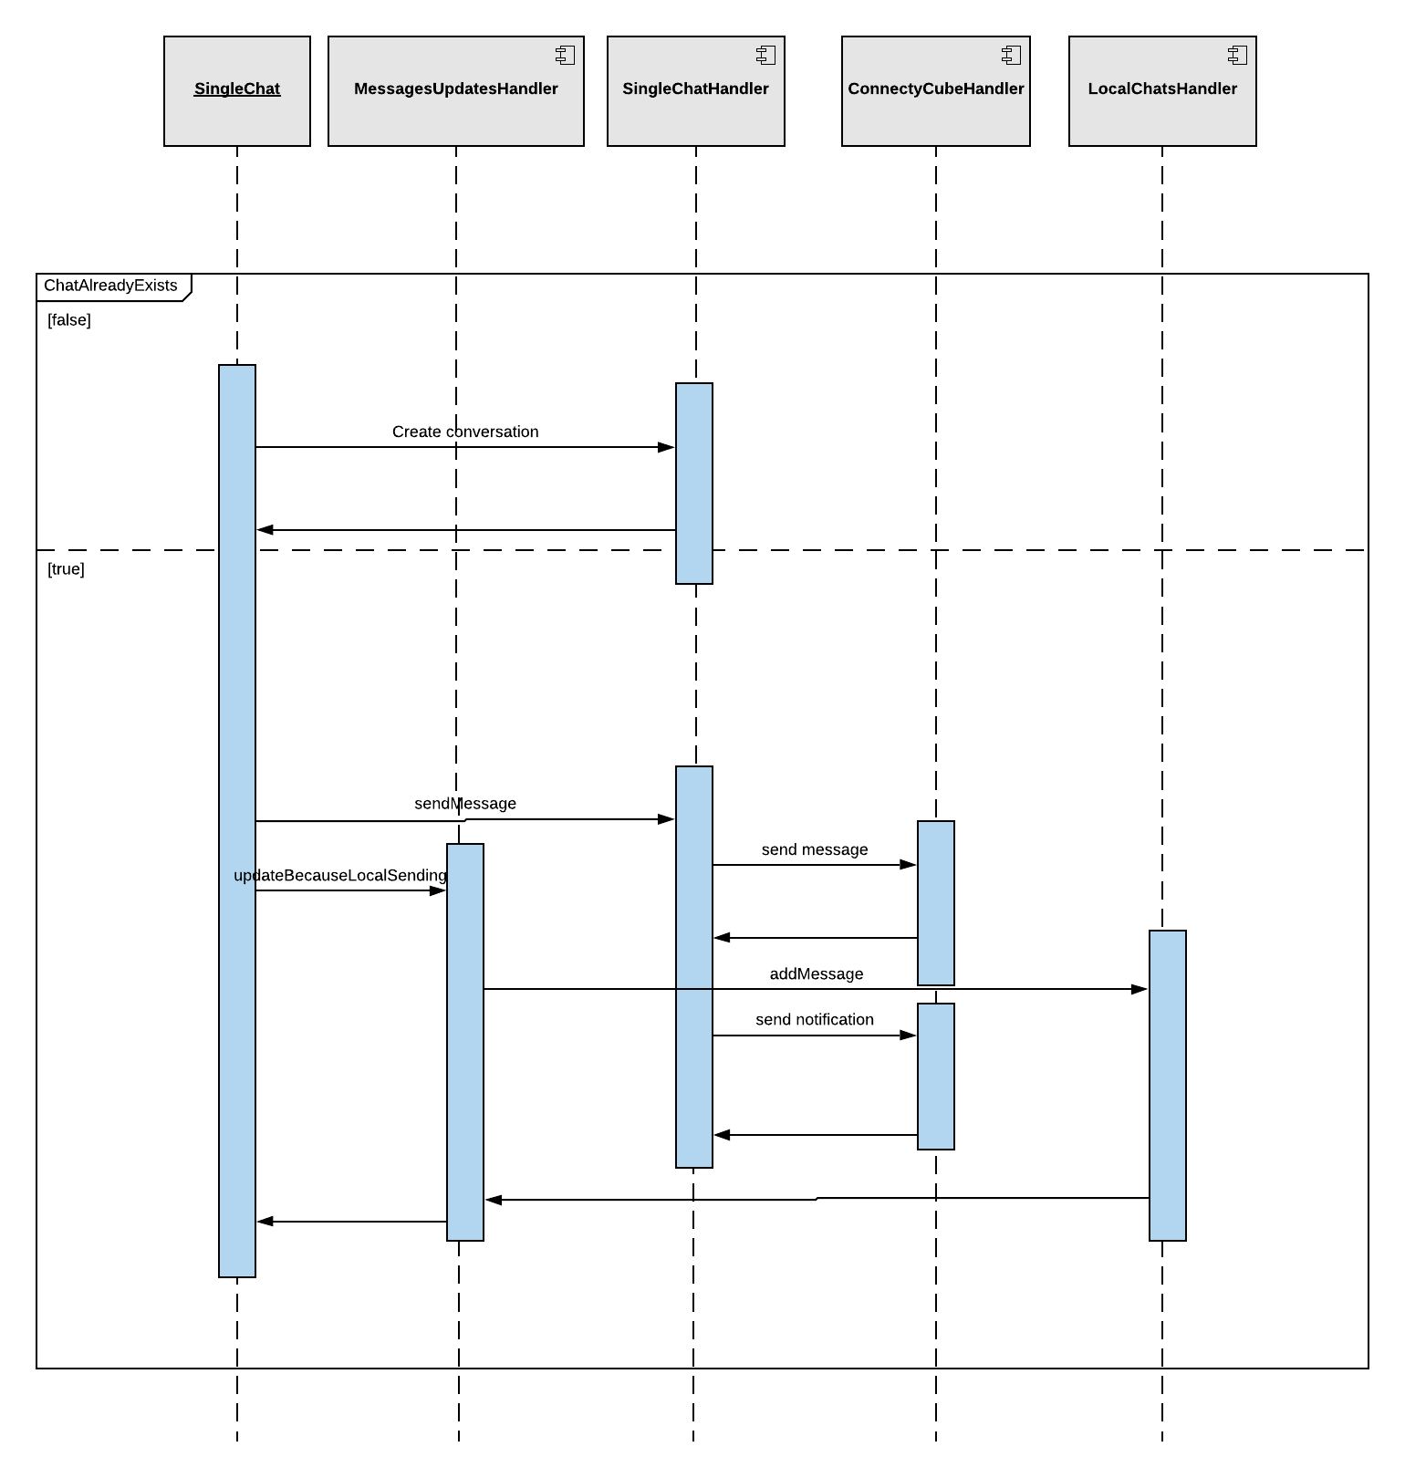
Runtime View - Sending a message

Slide 21
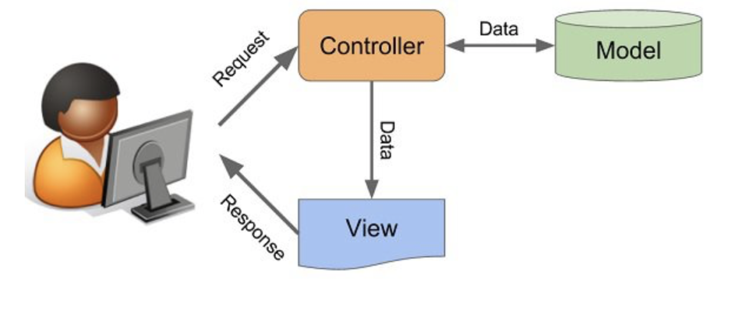

Architectural Styles and Patterns
Client - Server
MVC
XMPP
Publish-Subscribe

Slide 22
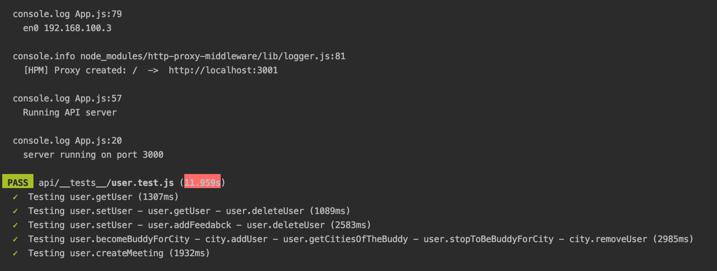
Test Plan
Through Jest:
the addition of a user
the deletion of a user
the addition of a feedback to a user
the addition of a buddy to a city
the deletion of a buddy from a city
the creation of a new meeting

